Slide 1
What can the Podiatric Surgeon do for Me?
The Diabetic Foot: Clear and Unpleasant Danger
Charcot Foot is the Worst (Down the Rabbit Hole)
Dr. William P Grant, DPM, FACFAS

Slide 2
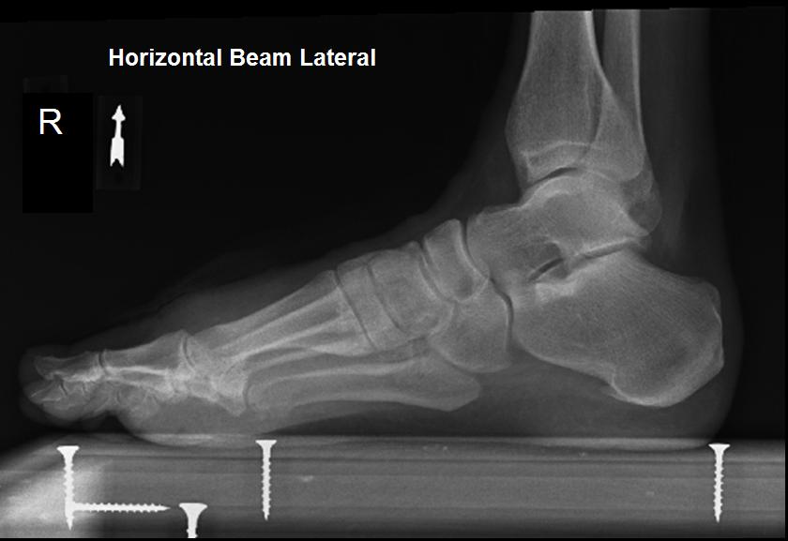
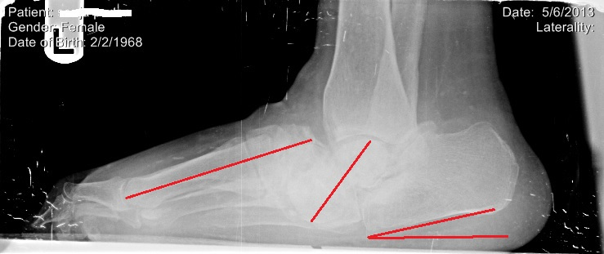
What is Charcot Arthropathy?
According to the AOFAS Charcot arthropathy, also known as Charcot foot and ankle, is a syndrome in patients who have neuropathy or loss of sensation. It includes fractures and dislocations of bones and joints that occur with minimal or no known trauma.​

Slide 3
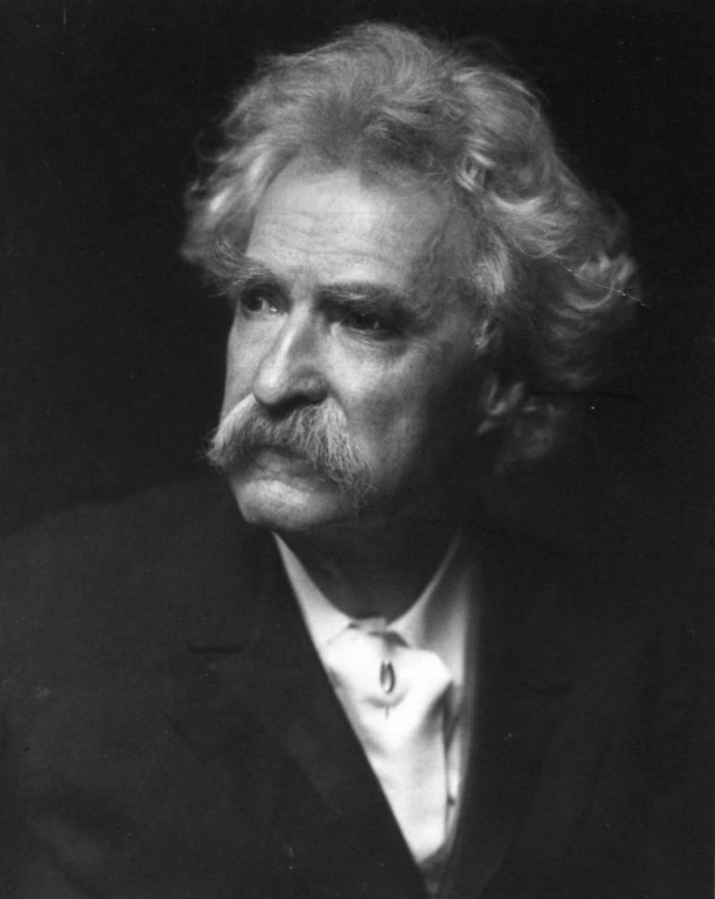
Mark Twain
Described three types of lies
Lies
Damn lies
Statistics

Slide 4
Epidemiology and Prevalence
Diabetic neuropathy is the leading cause of Charcot arthropathy in the modern world
Prevalence is up to 10% when Xray findings are used to make the diagnosis
Bilateral involvement can range from 9-75% and it principally effects the foot and ankle
1 Gouveri E, Papanas N. Charcot osteoarthropathy in diabetes: a brief review with an emphasis on clinical practice. World J Diabetes. 2011; 2(5):59–65.
2 Cavanagh PR, Young MJ, Adams JE, Vickers KL, Boulton AJ. Radiographic abnormalities in the feet of patients with diabetic neuropathy. Diabetes Care. 1994; 17(3):201-9.
3 Armstrong DG, Todd WF, Lavery LA, Harkless LB, Bushman TR. The natural history of acute Charcot's arthropathy in a diabetic foot specialty clinic. Diabet Med. 1997; 14(5):357-63.

Slide 5
Complications Following First Amputation
Contralateral amputation in 3-5 years (51%)
Instutionalization (25%)
Early death- within 3 years

Slide 6
The Cellular Basis of Charcot Foot (current thinking)

Slide 7
RANKL/OPG
OPG: decoy molecule binds up the RANKL and keeps it from activating the osteoclast
RANKL (receptor activator for N-F-Kappa- B Ligand): this is the binding molecule that tells the osteoclast to differentiate
RANK: The receptor that is positioned on the Preosteoclast

Slide 8
Increased Osteoclastic Activity in Acute Charcot's Osteoarthropathy: The Role of Receptor Activator of Nuclear factor-kappaB Ligand Mabilleau G, Petrova NL, Edmonds ME. Diabetologia. 2008
Aims:
Monitor OPG/RANKL in Charcot and controls
Materials and Methods:
Peripheral Mononuclear cells were isolated
cultured on glass cover slips
Applied then to dentin slices
Exposed to M-CSF, sRANKL, OPG in different concentrations
TRAcP was a stained marker of osteoclast activity
Results:
Acute Charcot patients demonstrates increased osteoclast differentiation and resorption in all concentrations
Conclusions:
RANKL dependent pathway is significant to Charcot pathogenesis
Excessive osteoclast activation
Target therapy?
RANKL inhibition

Slide 9
AGE/RAGE/sRAGE
AGE: Advanced Glycation Endproducts
Glycoprotein
Millard reaction
Occur in aging and chronic disease states
Cause damage to tissue via oxidative stress
Most common cross-link is glucospane
RAGE: Receptor for Advanced Glycation Endproducts
Receptor for the ligand AGE
Results in pro-inflammatory gene activation
sRAGE: Soluble Receptor for Advanced Glycation Endproducts
Isoform of RAGE
Without signaling domain
Counteracts RAGE

Slide 10
Loss of sRAGE Defense: a Cause of Charcot Neuroarthropathy? Witzke KA, Vinik AI, Grant LM, Grant WP, Parson HK, Pittenger GL, et al. Loss of RAGE defense: a cause of s neuroarthropathy? Diabetes Care. 2011;34:1617–21.
Results:
Worse peripheral and autonomic neuropathy
lower bone stiffness index respectively
No difference in bone mineral density
lower sRAGE levels than
Higher osteocalcin
Conclusions:
Failure of sRAGE defense against Oxidative stress
Osteoclast activated N-f-Kappa-B in a RANKL independent pathway
AGE-mediated osteoblast apoptosis
Intro:
Studied the relationship of sRAGE in bone metabolism
Materials and Methods:
DEXA
Calcaneal stiffness
sRAGE
NTX (collagen break down products)
Osteocalcin

Slide 11
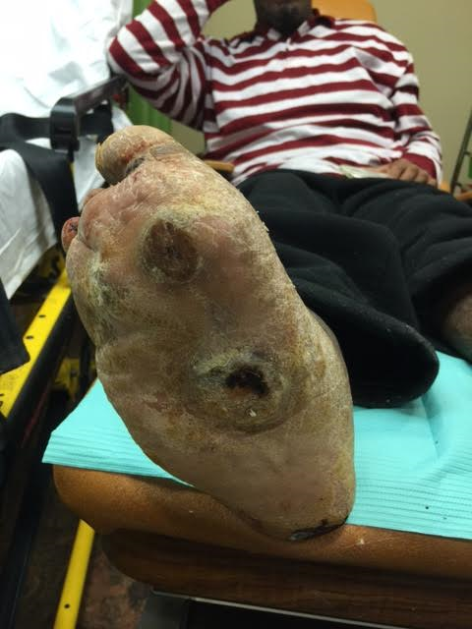
Correlating Cell Biology with Clinical Findings

Slide 12
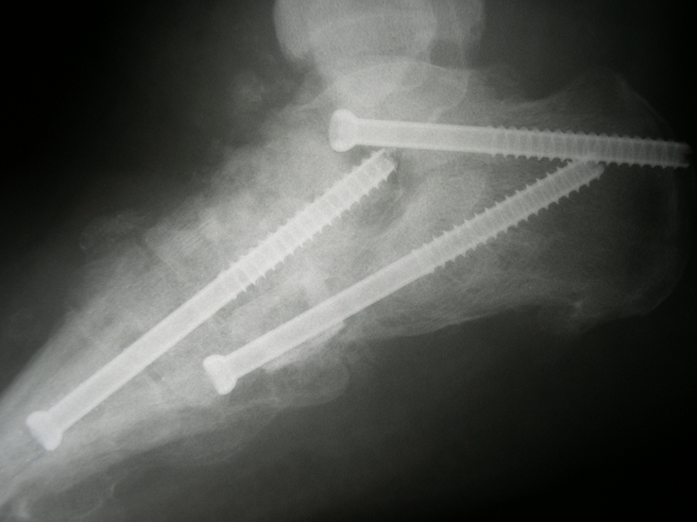
Dissimilarities Between Neuropathic Arthropathy of the Ankle and Midfoot: Does Anatomy Predict Osseous Metabolism? Grant et al. (Manuscript, 2015)
Aims:
Associate bone metabolism markers with fracture dislocation pattern
Materials and Methods:
Patients were identified as
Fracture pattern
Dislocation pattern
Anthropometric info obtained
Local DEXA
OPG/RANKL ratio
sRAGE
Osteocalcin
Peripheral DEXA

Slide 13
Results: Patient Population

Slide 14
Results: DEXA Scans

Slide 15
Charcot Characteristics: Fracture vs. Dislocation
Dislocation
Fracture

Slide 16
Charcot Characteristics: Fracture vs. Dislocation

Slide 17
Conclusions:
Charcot Ankle
Charcot Midfoot
Elevated Microfracture
low BMD
increased levels of Osteocalcin, RANKL increased bone turnover
High trabecular density within tibia metaphysis makes this region susceptible to fracture
Reduction in repair process
Elevated dislocation pattern
Near normal BMD
Relatively decreased osteocalcin
Lower RANKL suggests limited bone turnover
Higher Cortical bone content
sRAGE is lower and thus has more inflammatory

Slide 18
Stage of Disease

Slide 19
Stage of Disease: Eichenholtz/ Shibata & Schon Eichenholtz SN. Charcot Joints. Springfield, IL, USA: Charles C. Thomas; 1966. Shibata T, Tada K, Hashizume C. The results of arthrodesis of the ankle for leprotic neuroarthropathy. J Bone Joint Surg Am. 1990;72:749–756.

Slide 20
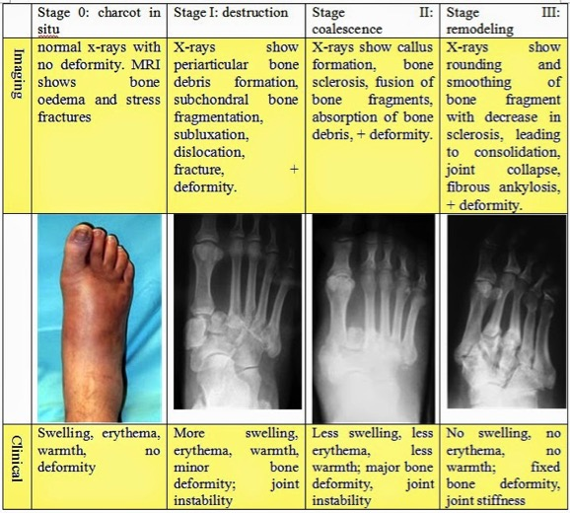
Stage of Disease: Eichenholtz/ Shibata & Schon Eichenholtz SN. Charcot Joints. Springfield, IL, USA: Charles C. Thomas; 1966. Shibata T, Tada K, Hashizume C. The results of arthrodesis of the ankle for leprotic neuroarthropathy. J Bone Joint Surg Am. 1990;72:749–756.
Aids in timing of procedures
Aids in the “language” of Charcot
No guidance of surgical treatment

Slide 21
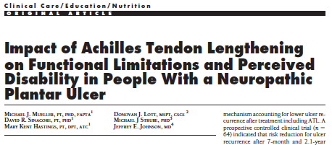
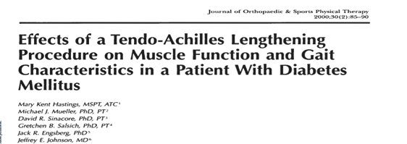
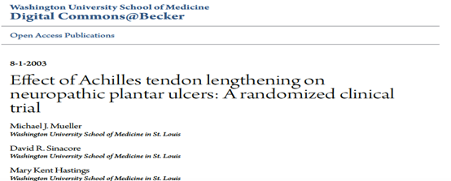
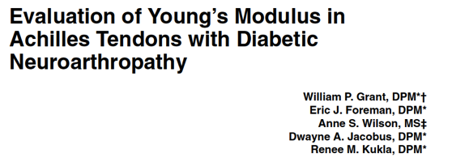
Charcot Characteristics: Equinus

Slide 22
Midfoot stability relies on ligaments which stabilize the joints from reactive gravity and Achilles tendon pull

Slide 23
In Charcot, Tendons are contracted, ligaments are weakened, eventually, the foot collapses

Slide 24
Young’s Modulus
Young’s modulus describes tensile elasticity, or the tendency of an object to deform along an axis; it is defined as the ratio of tensile stress to tensile strain
Stress
Strain
Force
Displacement

Slide 25
Experiment
29 Achilles tendons stretched to failure (Charcot n=20, control n=9) on Comten Biomechanical Testing instrument
Tendons measured with micrometer, then placed at length in instrument
Achilles Tendon was oriented vertically and stretched to pure failure at a rate of 10% per second

Slide 26
Results
Young’s Modulus substantially decreased in patient’s with confirmed Charcot
79.490 +/- 48.124 vs. 271.533 +/-86.194 (p=<0.001)
Stress (Force) also decreased
16.885 +/- 11.054 vs. 40.978 +/- 26.576 (p= 0.004)
Endpoint reached at lower forces compared to normal

Slide 27
Grant et. al
Collagen of surrounding ligaments showed increased cross-linking
Connective Tissue Showed decrease tensile strength
Leads to laxity of the structure
May also relate to the quality of collagen in the bone

Slide 28
Results
Pros:
Demonstrated visible evidence of organic alterations in Charcot Tissue
Suggested a Biomechanical component to Charcot
Demonstrates visible pathology to tissue of Charcot patients
Limitations:
Never demonstrated alterations in Bone or makes mention of bone abnormality

Slide 29
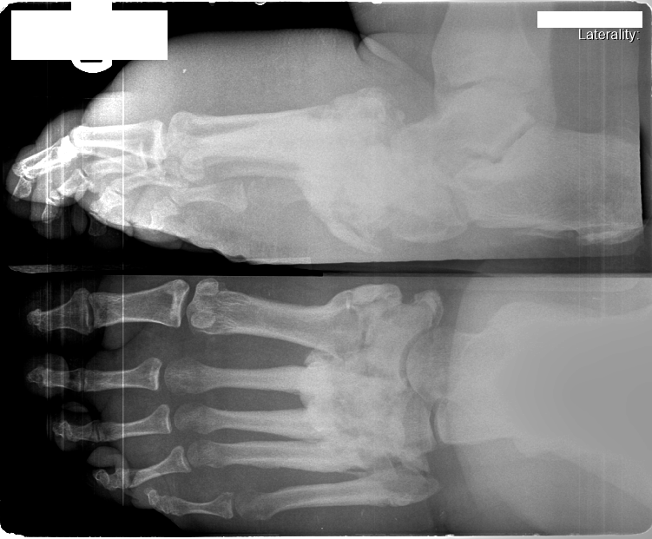
Radiographic Patterns

Slide 30
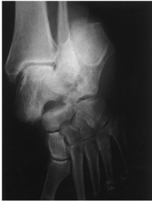
Charcot Characteristics: Fracture vs. Dislocation
Dislocation:
Failure of the ligaments
Normal bone quality
Fracture:
Failure of the bone
Diminished BMB
Makes prediction on bone quality
Fixation
Duration of NWB status

Slide 31
Histopathology

Slide 32
Trabecular Quality and Cellular Characteristics of Normal, Diabetic, and Charcot Bone La Fontaine et al. JAFAS 2011
Intro:
Analyze the histologic structure of Charcot bone compared to diabetics and healthy controls
Materials and Methods:
Bone decalcified and placed in paraffin for histomorphometric examination; sliced sections on Microtome and Dyed
Results:
N=23
Controls= 7
DM= 8
Charcot= 8
Charcot Trab. = DM
Charcot Trab. < Controls
Charcot bone appeared woven
Conclusions:
Current treatment modalities (plates and screws) may not be appropriate in the Charcot patient.
Notes:
Woven bone photo

Slide 33
24 y/o type I diabetic charcot & osteomyelitis

Slide 35
Immediate & 12 week post op

Slide 36
12 week post op
*Note the woven bone*

Slide 37
Histology of Spongy Bone
Abundant in Metaphysis
Thickness, density and porosity changes with age, gender and anatomic location
Trabeculea give strength to bone
Load conductor
More susceptible to hormone regulation
Higher turnover rate
5-6 months

Slide 38
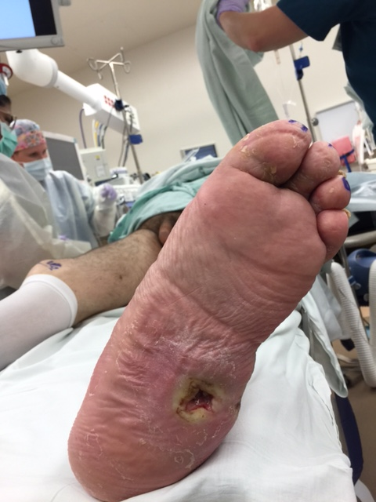
Current Treatments for Charcot Foot

Slide 39
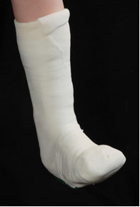
Total Contact Cast for Treatment of Charcot

Slide 40
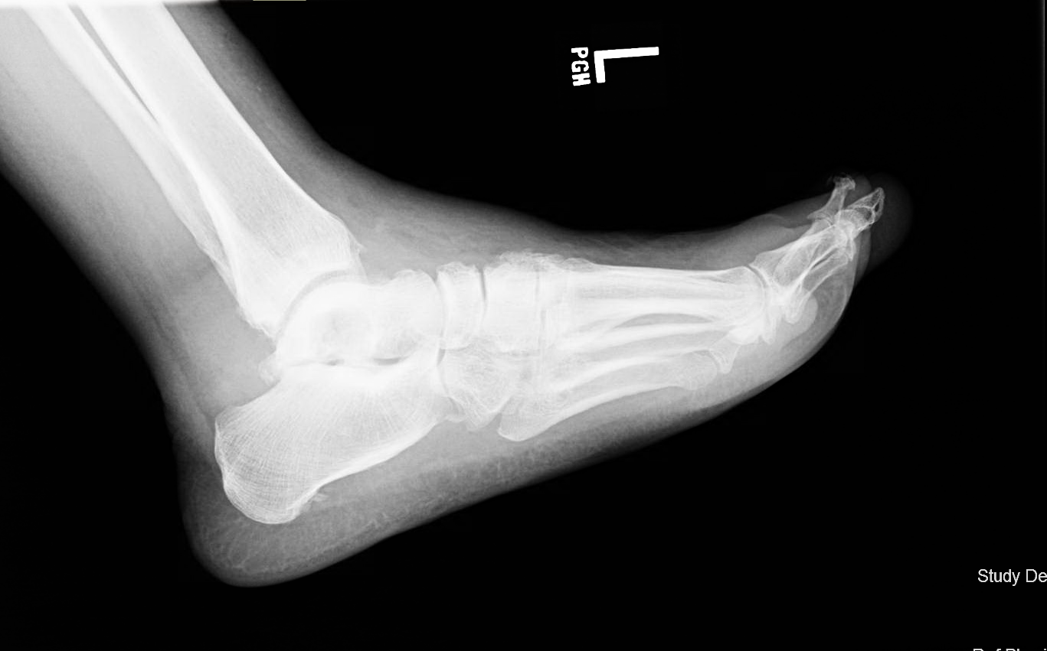

Slide 41
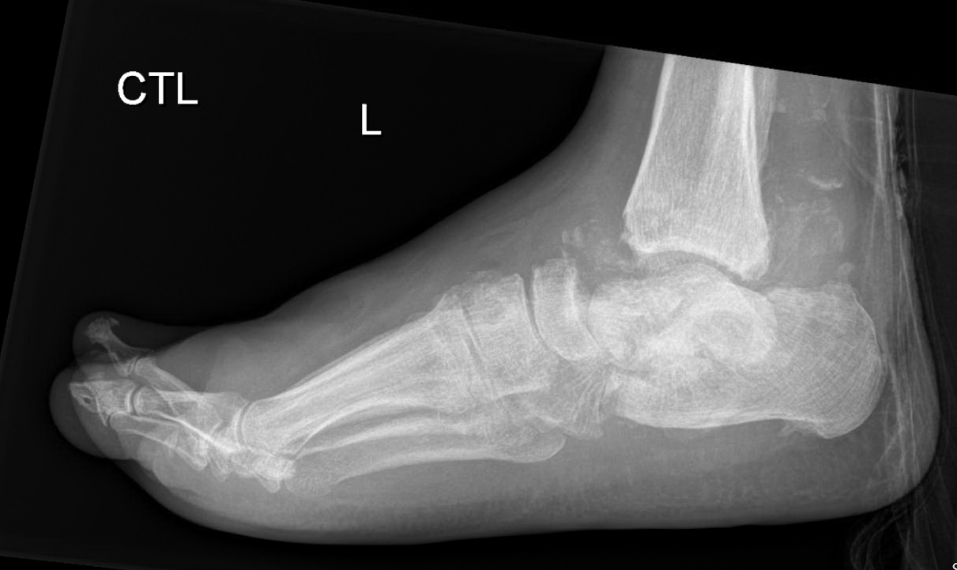

Slide 42
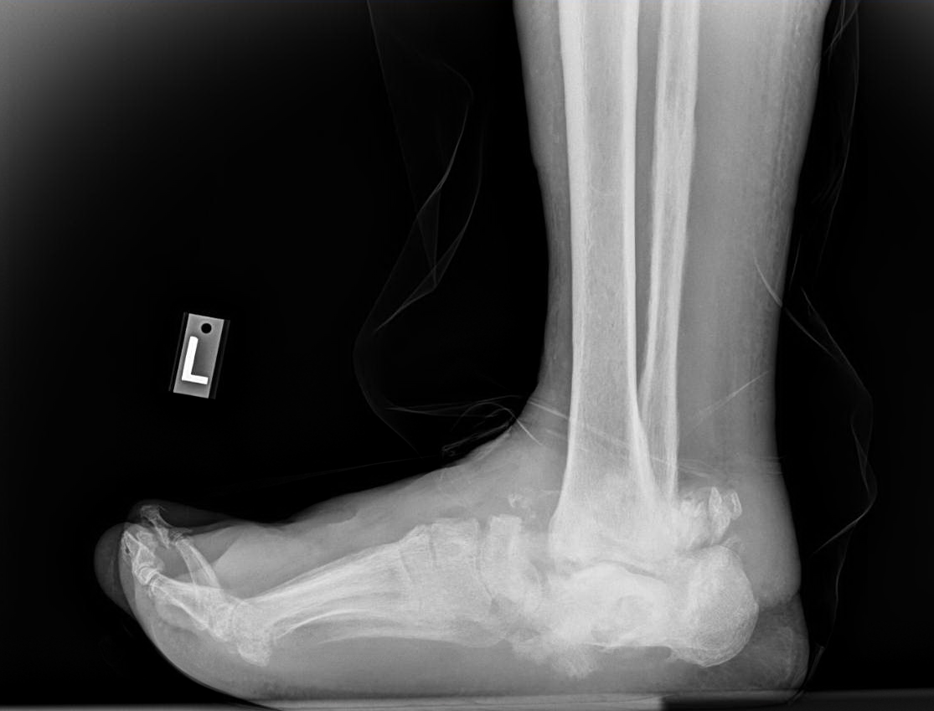

Slide 43
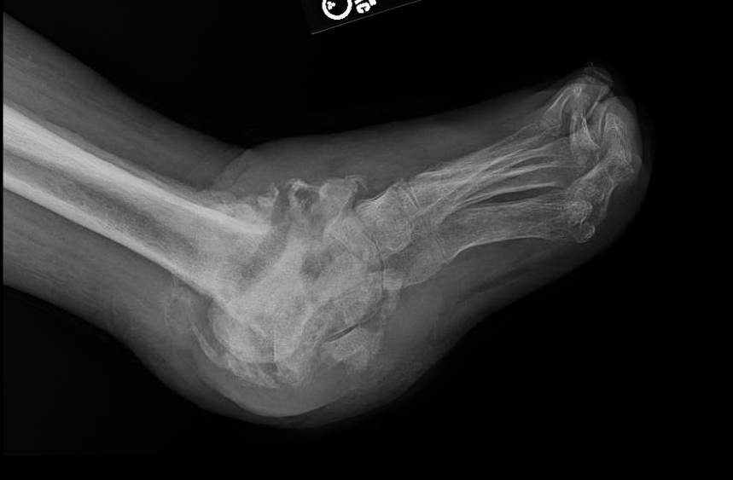

Slide 44
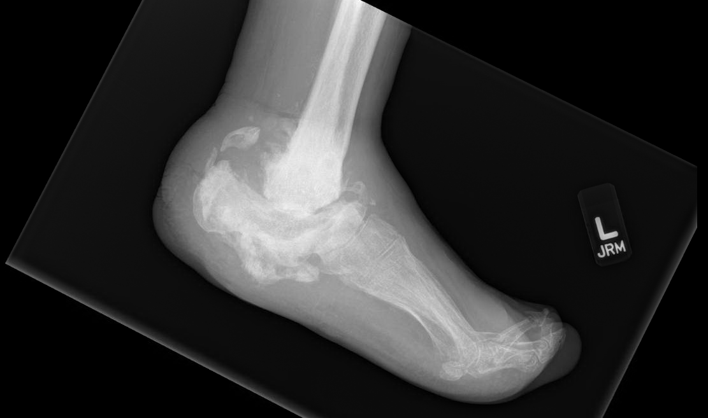

Slide 46
While total contact casting is currently considered the “gold standard”, the need for surgical stabilization is apparent to those who care for these patients

Slide 47
Indications for Charcot Surgery
Infection
Nonhealing wounds
The Charcot Ankle
Chronic edema and inability to ambulate
Anatomic deformity not amenable to casting / bracing
As an alternative to BKA

Slide 48
One alternative approach to the Charcot Foot

Slide 49
Major Tenants of the “Superconstructs”
1) Fusion is extended beyond the zone of injury to include joints that are not affected to improve fixation 2) bone resection is performed to shortened the extremity to allow for adequate reduction of deformity without undue tension on the soft tissue envelope 3) the strongest device is used that can be tolerated by the soft tissue envelope
4) The devices are applied in a position that maximizes mechanical function

Slide 50
Sammarco’s Superconstruct (2009)

Slide 51
Beaming as an alternative to Superconstruct
Beaming of the medial column via large diameter cannulated screws was first presented at the American College of Foot and Ankle Surgeons Scientific Seminar February 1997 (over 20 years ago now)
Beaming of the medial and lateral columns is the key to durable Charcot foot repairs of the hindfoot or lisfranc’s (tarsal metatarsal) deformities.

Slide 52
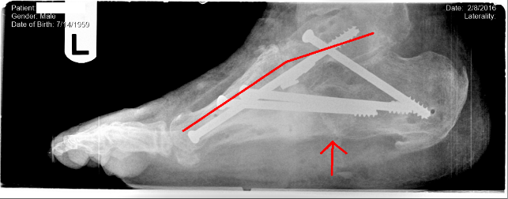
Mechanical Goals of Fixation
Beaming
Works in load-sharing and re-enforcement
Load share dependent upon bone, screw interface
Required minimal dissection
Internal to the bone allowing for aggressive extension “past the pathology” (Sammarco agreed)

Slide 53
Choosing Fixation
Beaming follows a series of engineering calculations that respect
Tissue Biology
Biomechanical principles of the foot

Slide 54
Closer Look at the Math
High bending moments at the metatarsal cuneiform joint
Lisfranc’s joint receive extreme loading during gait

Slide 55
Bending Moment Calculation
Bending Moment- A moment is rotational force that occurs when a force is applied perpendicularly to a point at a given distance away from that point.
It is calculated as the perpendicular force multiplied by the distance from the point.
Bending Moment is simply the bend that occurs in a beam due to a moment

Slide 56
Bending Moment Calculation
“Moments” calculated at areas of joints
Area of high force
We assume no rotational motion in beam as it transverse intramedullary canal
The foot is also without motion.

Slide 57
Stress Calculation
Once the bending moment has been calculated a stress calculation is performed
Takes advantage:
Material
Cannulation diameter
Bending moment
Safety factor of 2 gives the required diameter of screw needed.

Slide 58
When Beams Fail: Based on Calculations
Material is weak
Titanium is weaker than stainless
Weight of the patient
Exceeds 2x safety factor
Diameter of the beam
Based on a cannulated system
Failure of arthrodesis
Non-prepared joints
NO CURRENT AVAILABLE SCREW HAS A 2X SAFETY FACTOR FOR A 300LBS PATIENT

Slide 59
Technique
Left foot reconstruction including:
1. Tendon Achilles lengthening
2. Wedge osteotomy or anatomic arthrodesis
3. Beaming of the columns 4. Application of Ilizarov fixation for compression

Slide 60
Technique
Coalescence phase of Charcot
Non-healing ulcer due to pressure

Slide 61
Technique
Abnormal Meary’s angle
Cuboid dislocation

Slide 62
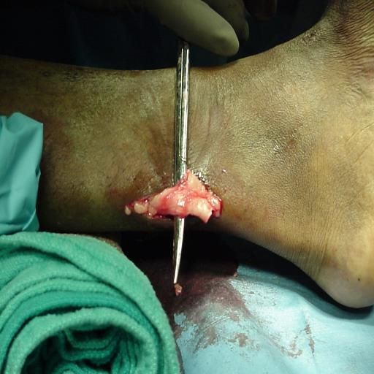
Technique: TAL

Slide 63
Technique: Midfoot Wedge
Measure it in millimeters, mark it with chalk, cut it with an axe

Slide 64
Technique: Beaming the Medial Column

Slide 65
Technique
Beaming of the lateral column

Slide 66
Technique
The lateral column beam has reduced the dislocation of the cuboid

Slide 67
Technique
Meary’s angle must be reduced to zero

Slide 68
Technique
Fluoroscopic guidance is essential (always take 2 views)

Slide 69
Technique
Anatomic reduction

Slide 70
Technique

Slide 71
Beaming the Columns for Charcot Diabetic Foot Reconstruction: A Retrospective Analysis
We Retrospectively reviewed the radiographic correction of deformity of 71 Charcot foot surgical reconstructions between January 1994 to January 2008.
Deformities consisted of either
Hindfoot
Lisfranc’s
Combination (combo) hindfoot/lisfranc’s deformities.
We compared pre and post-operative weightbearing lateral and AP radiographs to measure the radiographic correction of deformity.
All post-operative measures were taken no less than 3 months after frame removal.

Slide 72
Beaming the Columns for Charcot Diabetic Foot Reconstruction: A Retrospective Analysis Grant et al JFAS, 2011
Aim:
Better understand clinical outcomes associated with beaming
Materials and Methods:
Radiographic pre and post-operative comparison
Meary’s
Calcaneal Inclination
TMT angle
Complications
Pin tract infection
Broken pin
OM
Transfer lesions
Ulceration
Failure
Results:
N= 70
Mearys p <.001
CC p = 0.54
TMT p<.001
TN p = .002
Complications:
- Largest complication wound dehiscence
Conclusions:
Significant improvement in radiographic alignment
Maintenance of correction
Complications related to medial incision dehisence

Slide 73
Measured Radiographic Angles
TMT
CC
M
CI
TN

Slide 74
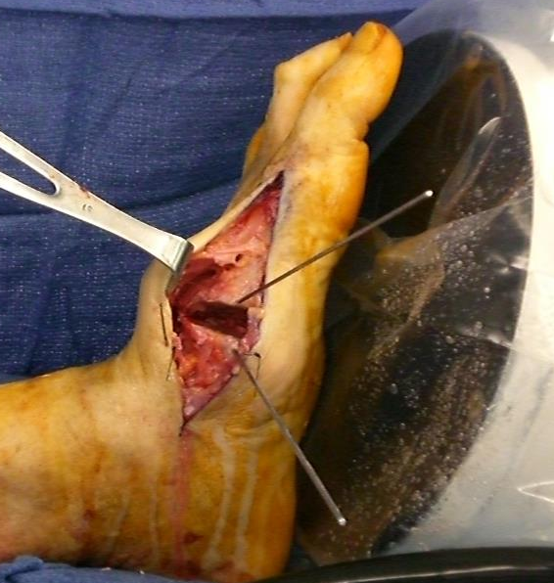
Lisfranc's wedge osteotomy with k-wire
The wedge works with the beams

Slide 75
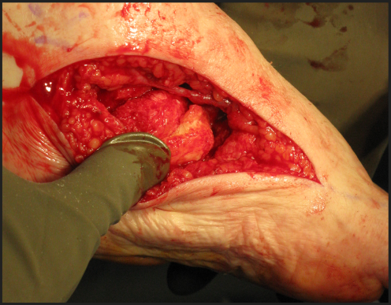
Hindfoot navicular and cuboid extirpated and re-implanted with grafting

Slide 76
Method and Procedures
Patient Satisfaction:
Used a single survey question
Patients were asked to answer YES or NO to the question:
“Would you have the surgery again?”
A response of “Yes” expressed patient satisfaction with procedure outcome.
A response of “No” expressed dissatisfaction with procedure outcome.

Slide 77
Sample Population Distribution
type II

Slide 78
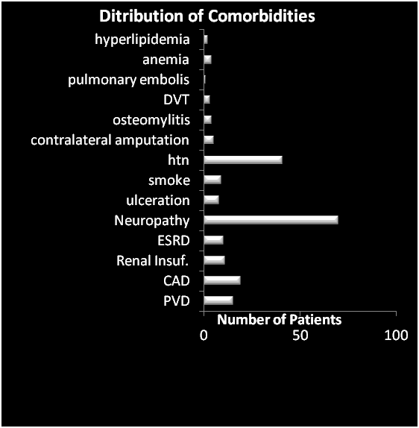
Sample Population Distribution

Slide 79
Results
71 Charcot reconstructions were performed
22 (31%) Isolated Hindfoot Deformity
20 (28%) Isolated Lisfranc’s Deformity
29 (41%) Combination (Combo) Hindfoot and Lisfranc’s Deformity.
Mean follow up period was 31 months
Average time in an external fixator of 9 weeks.

Slide 80
Results
Distribution of Internal Fixation
Number of patients which received each method of fixation

Slide 81
Patient Satisfaction
Results
47 patients completed the survey
46 patients responded “Yes”
1 patient responded “No” (pain and discomfort was the same after surgery).
98% patient satisfaction with procedure outcome.
Overall, patient satisfaction was positive with respect to the surgery.

Slide 82
Discussion
Medial column “beaming” is a intramedullary fixation thru the 1st metatarsal, medial cuneiform, navicular and into the talar body.
It shares the load with abnormal bones, ligaments and joints (Rebar in concrete).
The study suggested that locking the subtalar joint improved the long-term result of stability

Slide 83
Case Studies and Videos

Slide 84
Neuropathic, diabetic 60 year old shipyard worker with hallux amputation and combination of bone and ligament Charcot failure with ulceration

Slide 85
Patient returned to work early, used no bracing or shoe supports, and failed to follow up

Slide 86
Medial column failure = extrusion of the cuboid, attendant screw with osteomyelitis, and recurrent lateral ulcer. Beams were removed, given IV antibiotics, and antibiotic beads placed

Slide 87
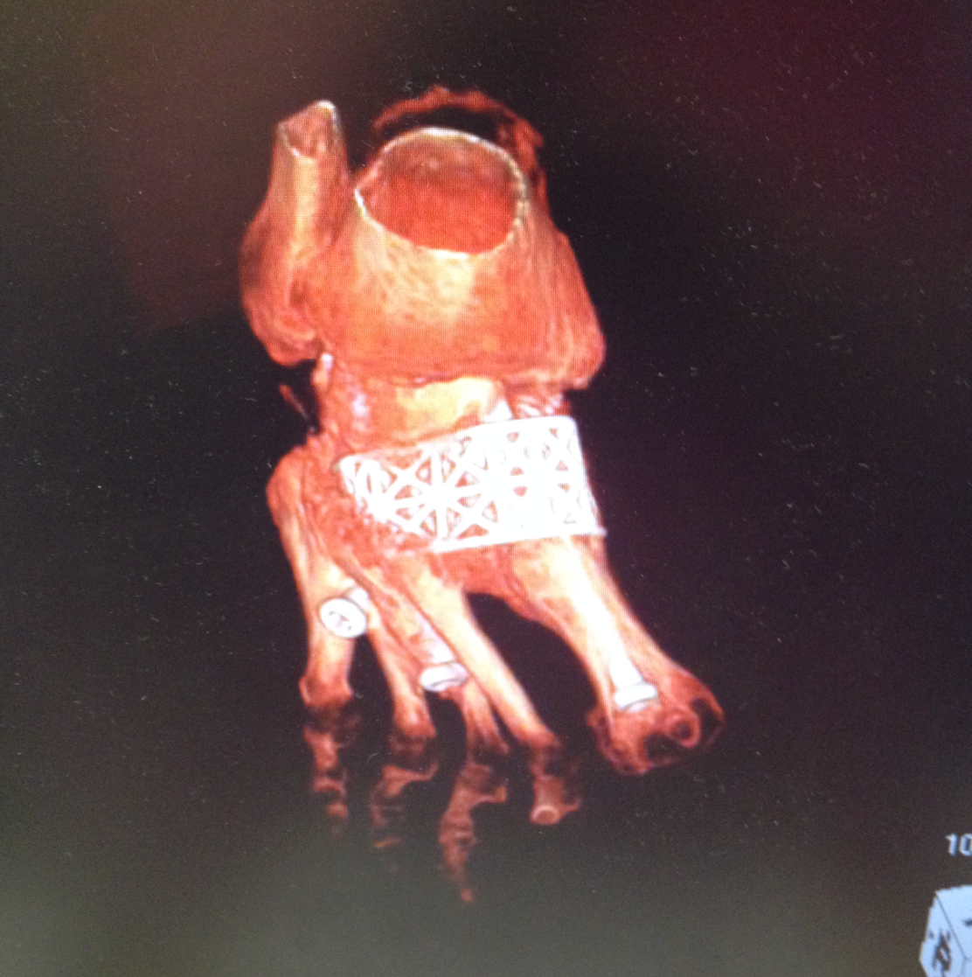
Placement of a custom 4web titanium midfoot cannulated for beams
Section modulus of 4web prohibits failure of construct

Slide 89
Case 2: 63 year old type II DM, PAD, and bilateral surgically stabilized Charcot foot
Developed Charcot ankle on the left

Slide 90
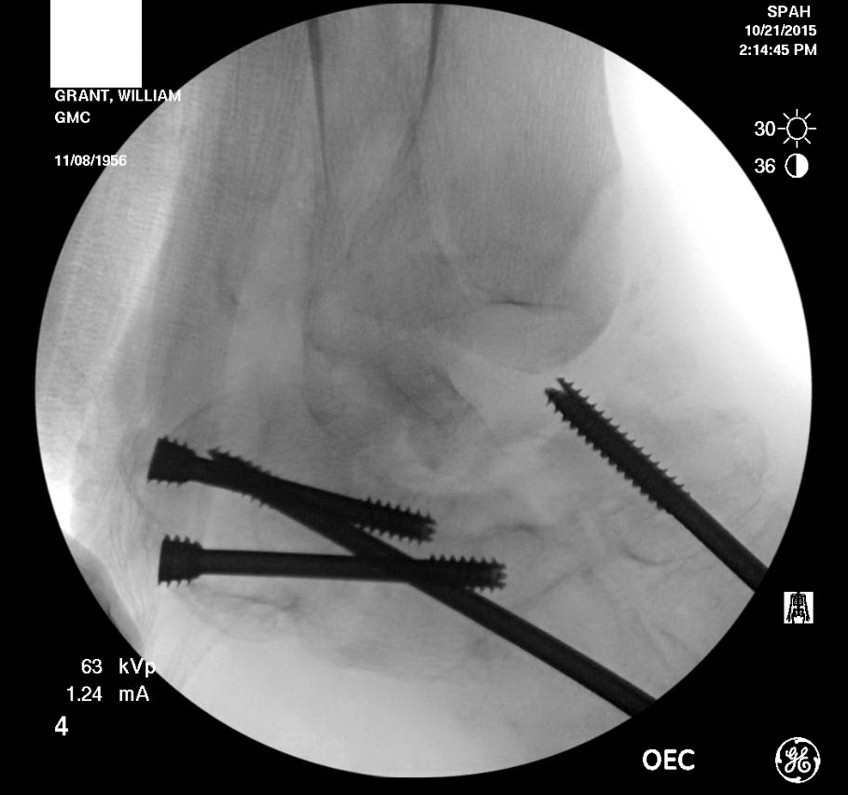
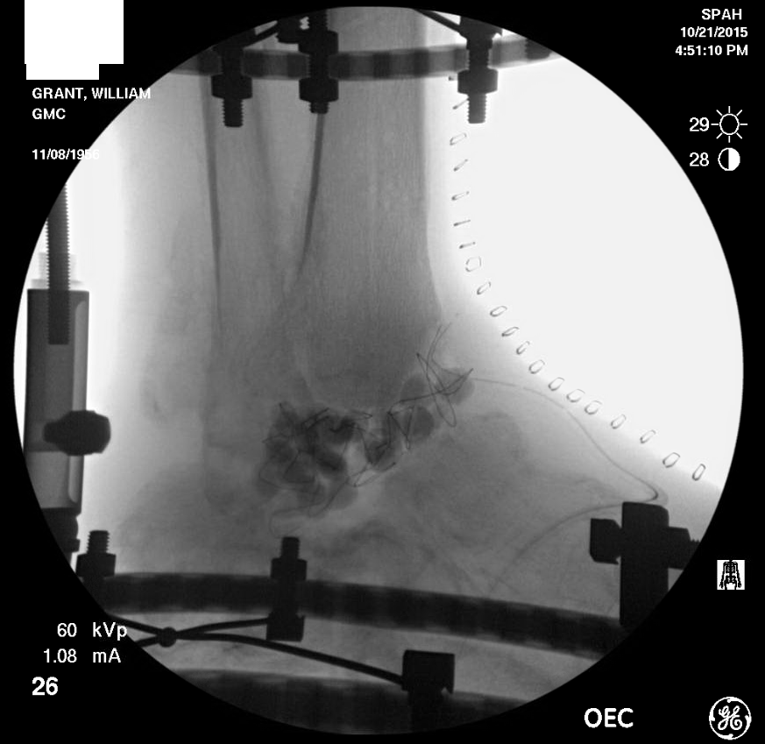
Left Charcot ankle evaporated
Hardware removed, beads placed (no infection)

Slide 92
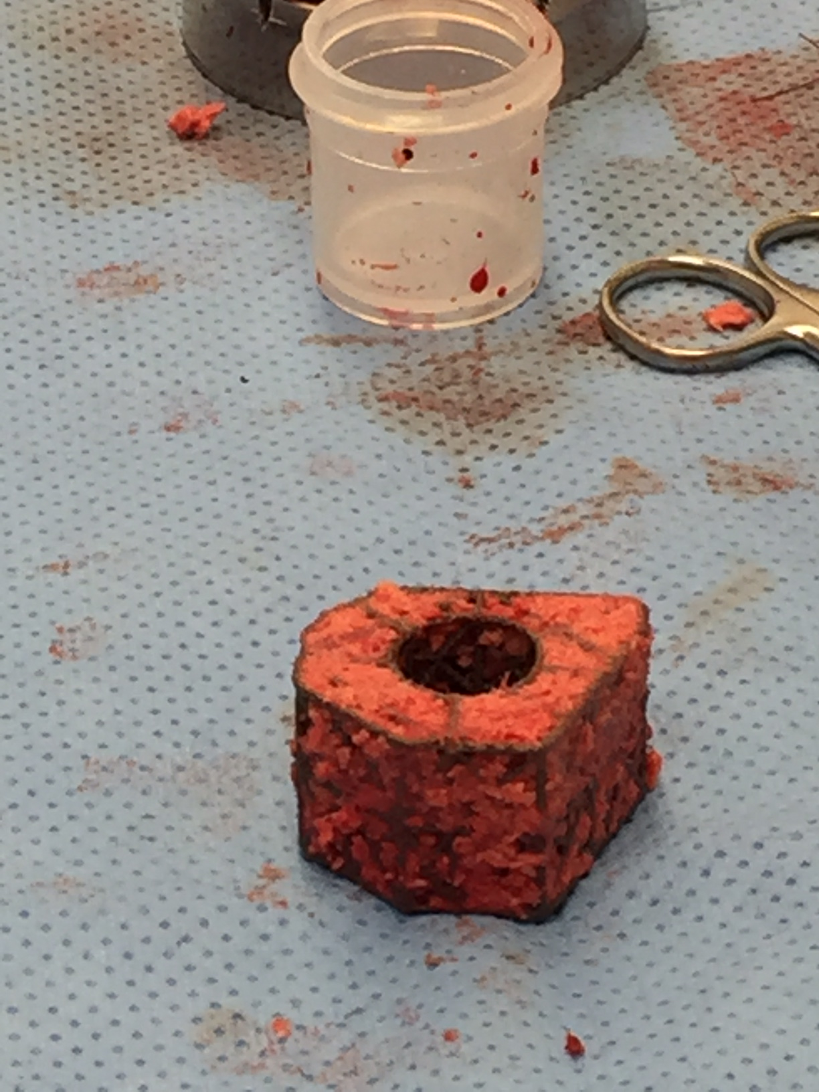

Slide 93
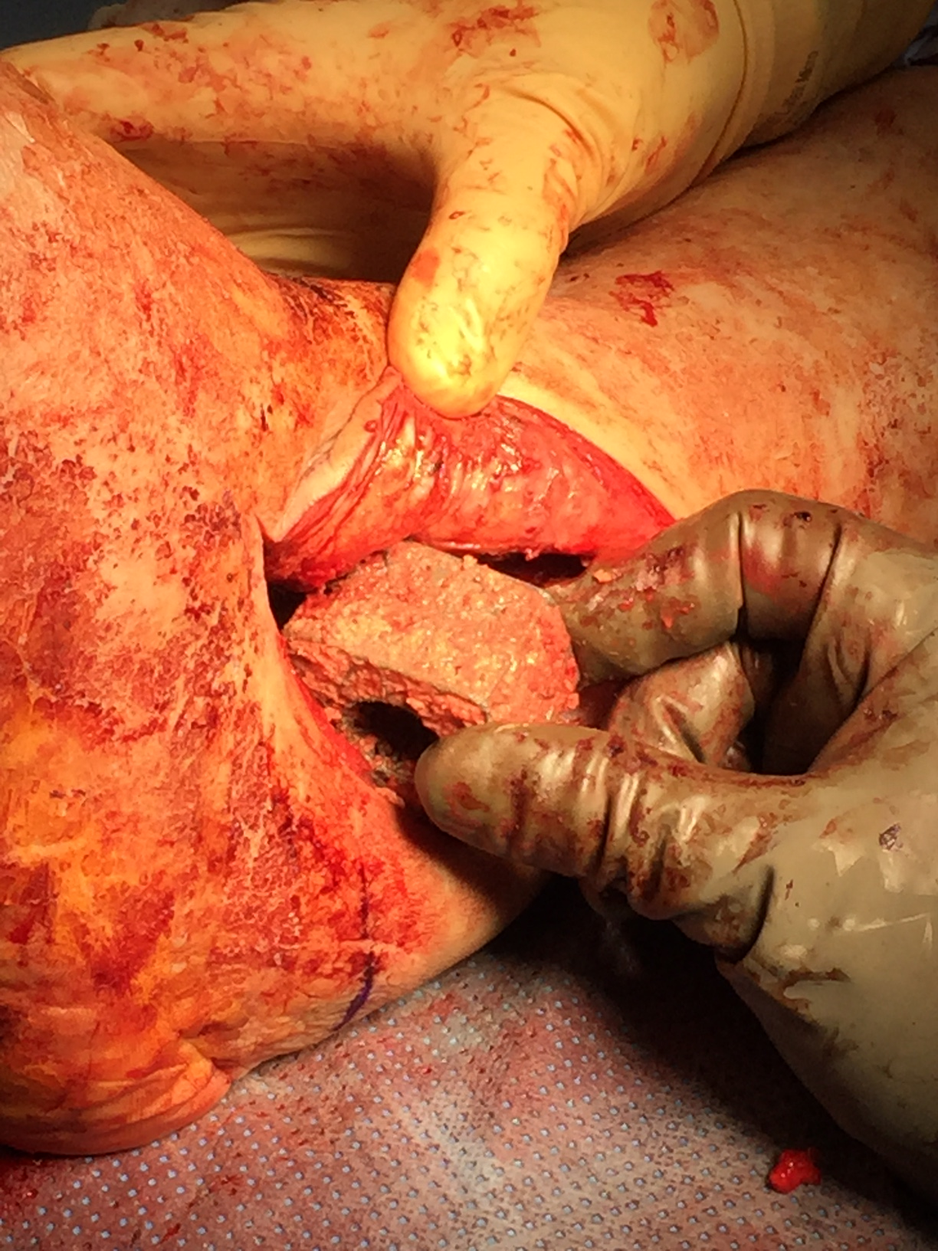

Slide 94
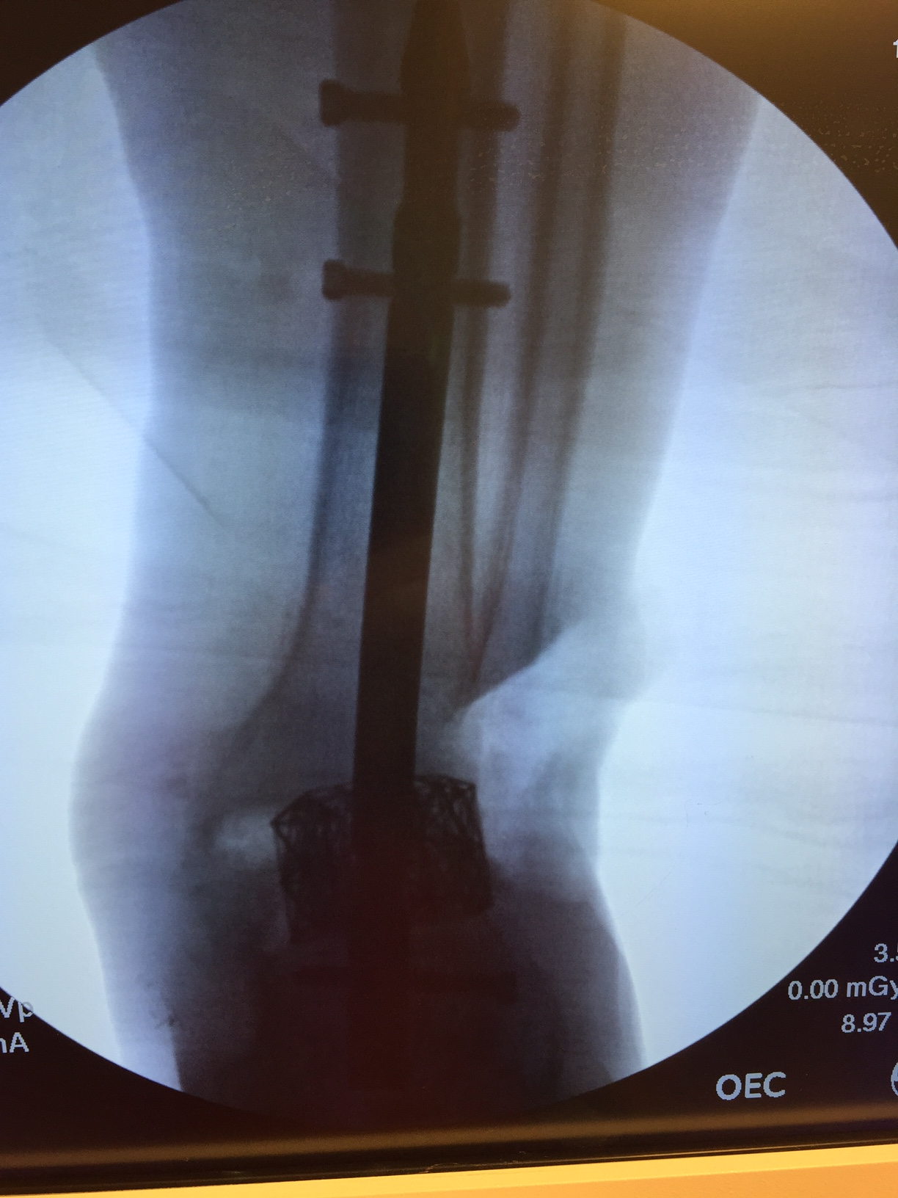
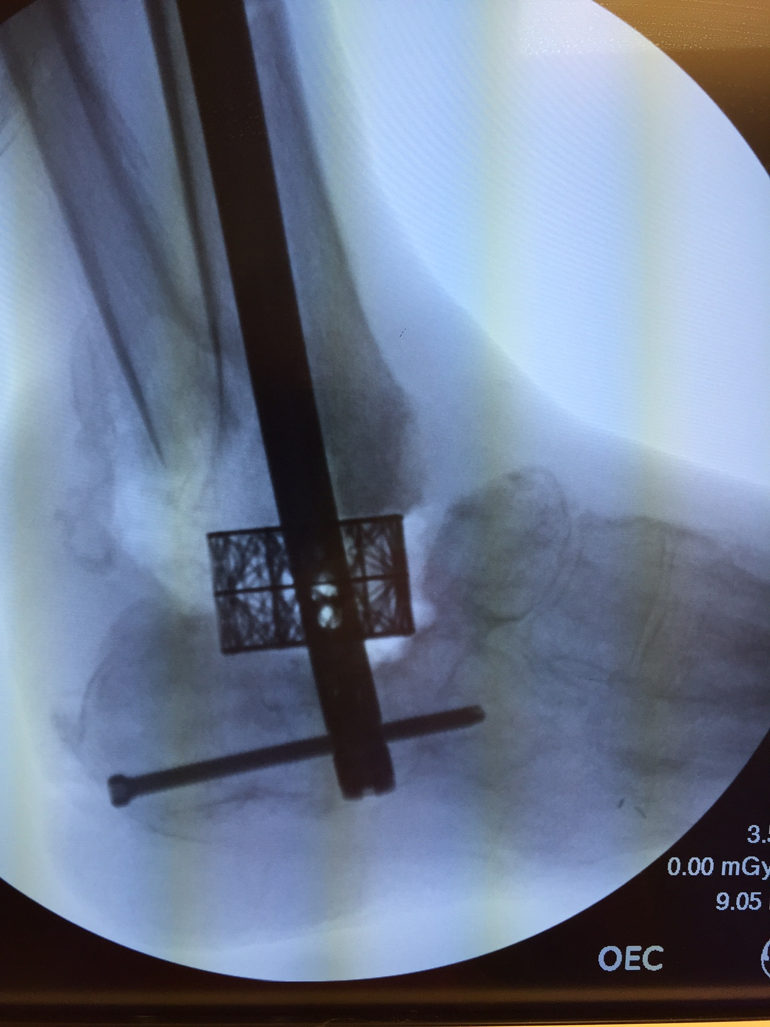

Slide 96
A year and a half later the patient remains working in the shipyard daily

Slide 97
Case 3: 43 year old type II DM with severe Charcot foot dislocation

Slide 98
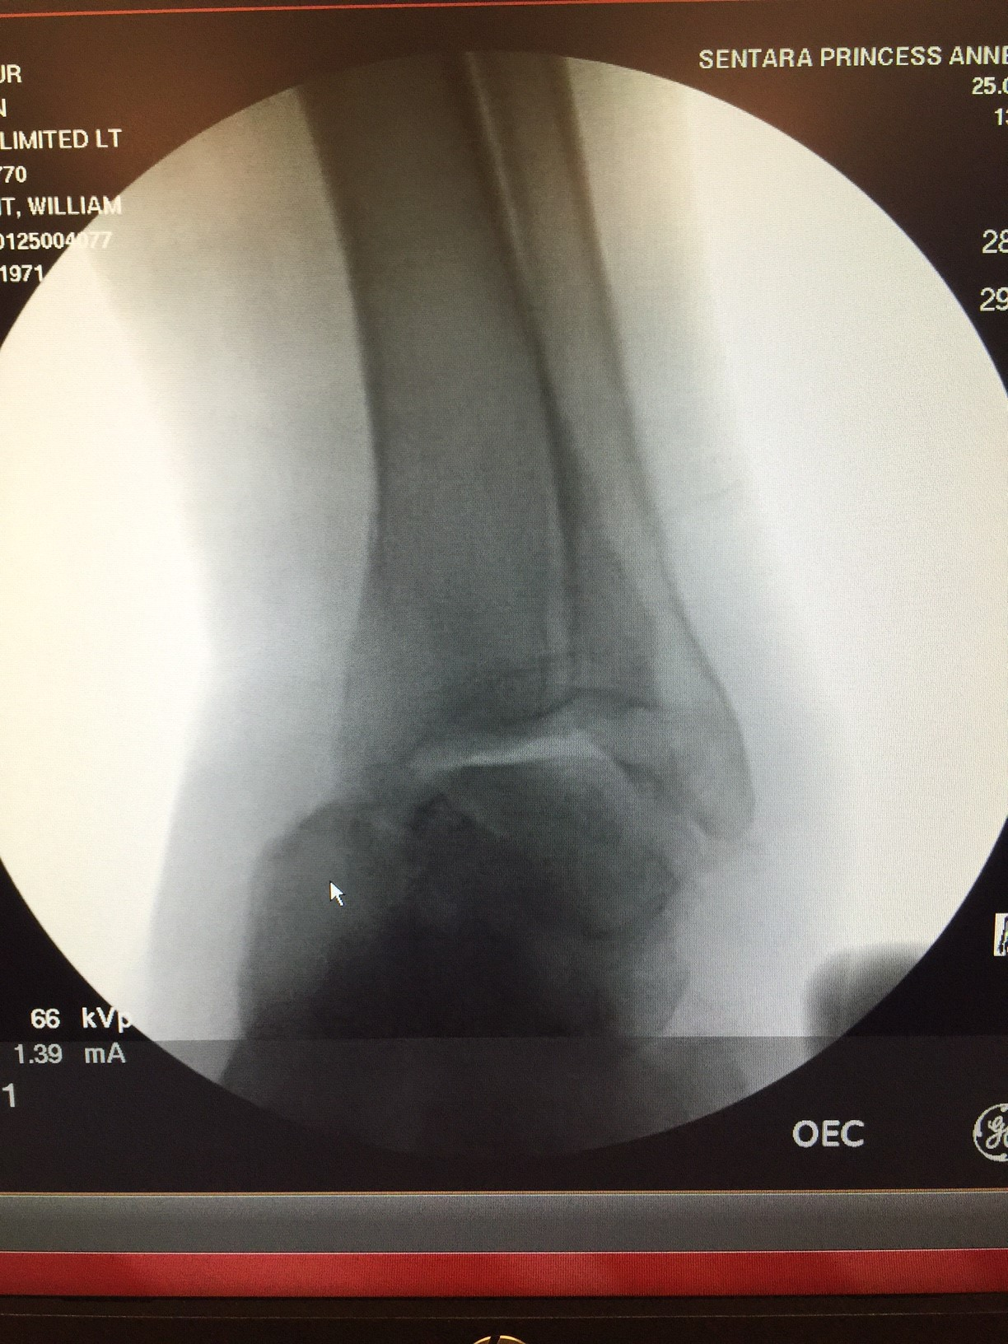

Slide 99
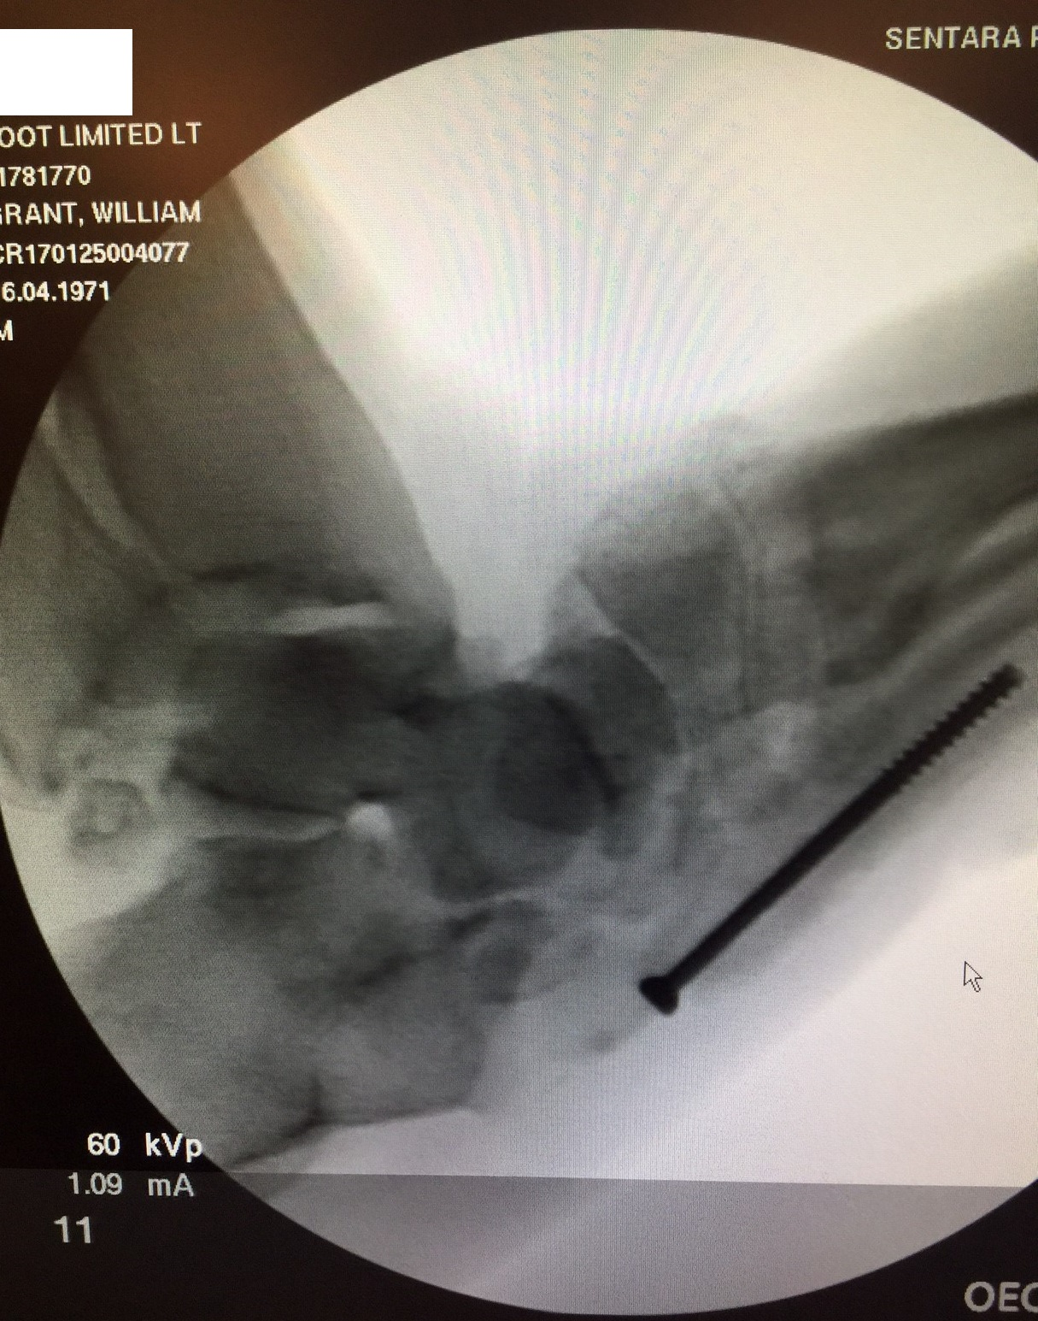

Slide 101
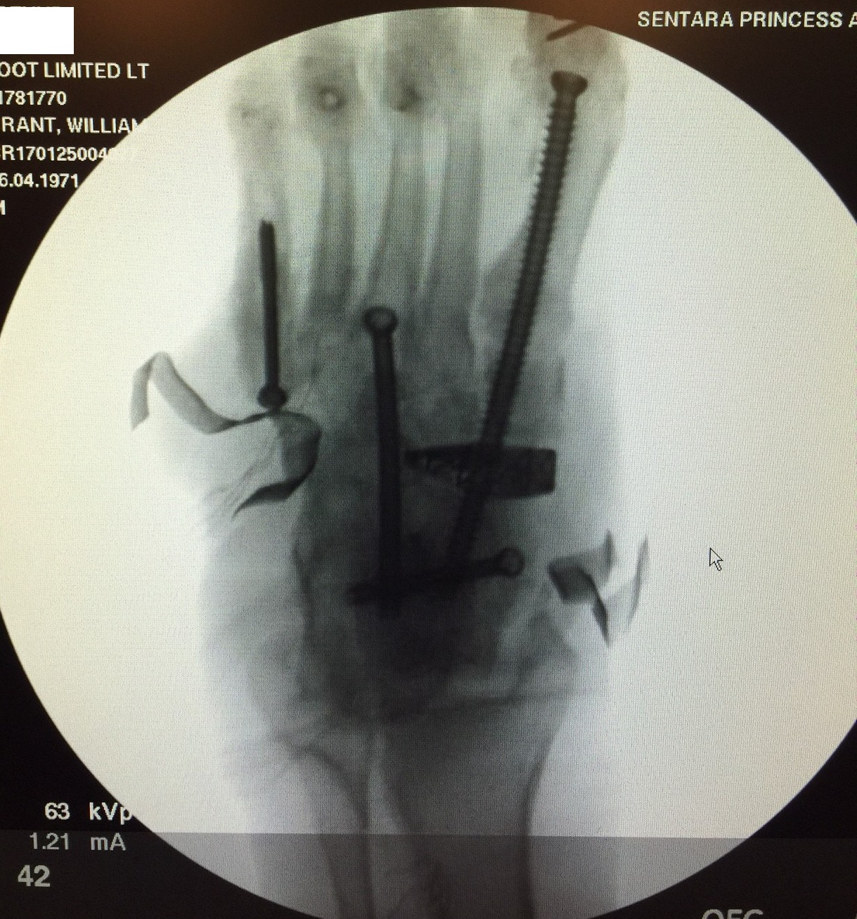

Slide 103
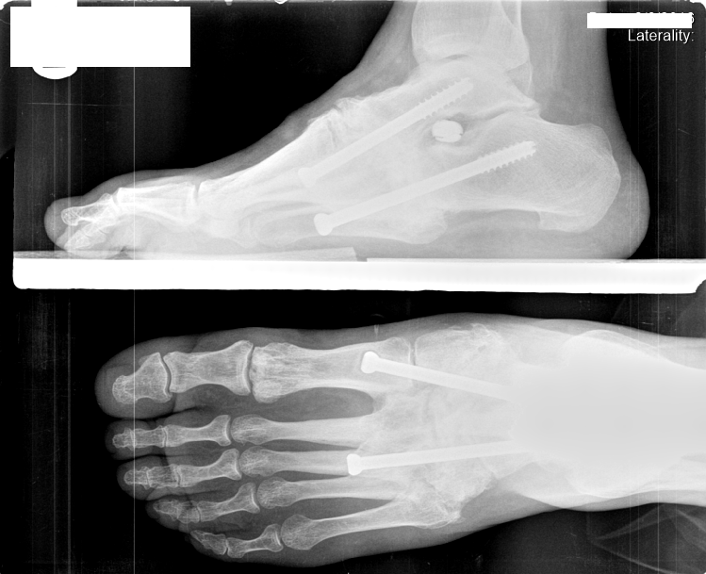
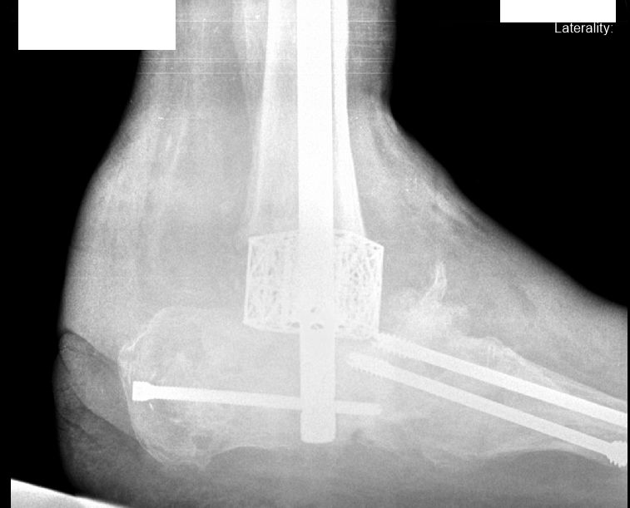
Come down the rabbit hole: My Recommendations:
In a dislocation-type Charcot, the recommendation is beaming with joint preparation of all joints of the arch
In a bone-type Charcot, the recommendation is 4web with internal and external fixation for a period of time long enough to allow bone ingrowth

Slide 104
The END
Quiz Time!

Slide 105
References
Childs M, Armstrong DG, Edelson GW. Is Charcot arthropathy a late sequela of osteoporosis in patients with diabetes mellitus? J Foot Ankle Surg 1998;37:437-9.
Cundy TF, Edmonds ME, Watkins PJ. Osteopenia and metatarsal fractures in dia- betic neuropathy. Diabet Med 1985;2:461-4.
Jirkovska AP, Kasalicky P, Boucek P, Hosova J, Skibova J. Calcaneal ultra- sonomentry in patients with Charcot osteoarthropathy and its relationship with den- sitometry in the lumbar spine and femoral neck and with markers of bone turnover. Diabet Med 2001;18:495-500.
Mabilleau G, Petrova NL, Edmonds ME. Increased osteoclastic activity in acute Charcot's osteoarthropathy: the role of receptor activator of nuclear factor-kappaB ligand. Diabetologia. 2008;51:1035–40.
Witzke KA, Vinik AI, Grant LM, Grant WP, Parson HK, Pittenger GL, et al. Loss of RAGE defense: a cause of s neuroarthropathy? Diabetes Care. 2011;34:1617–21.

